Slide 1
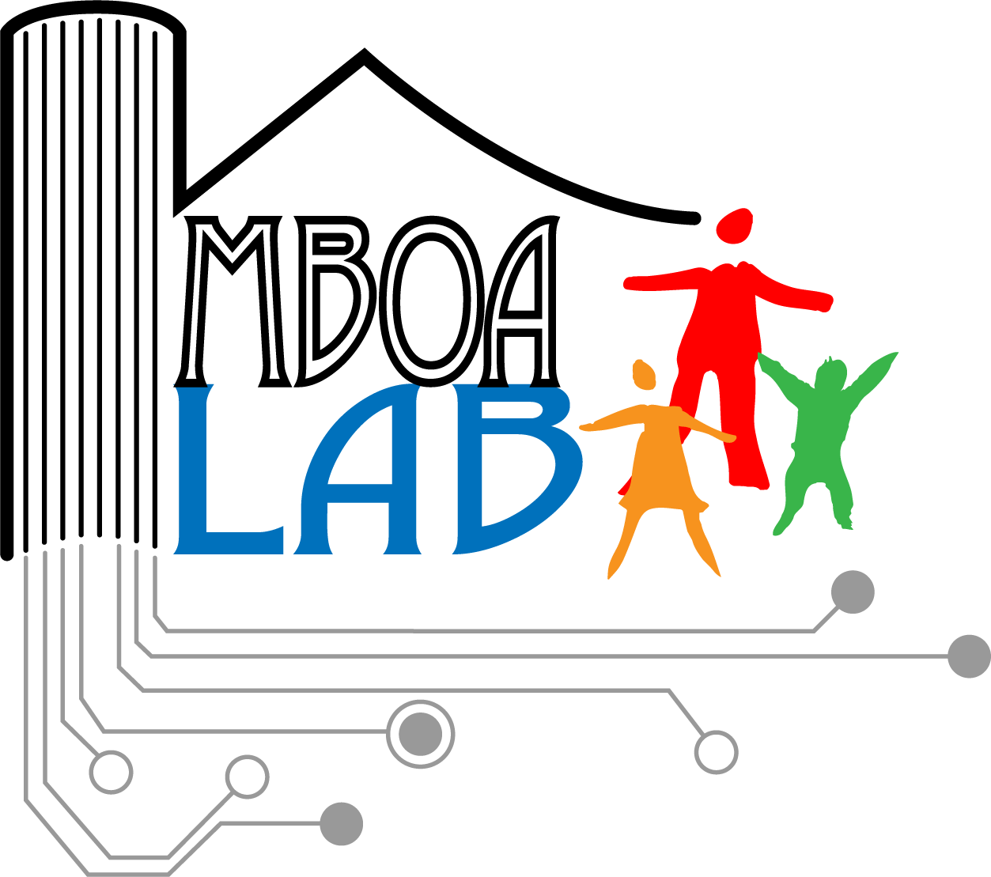
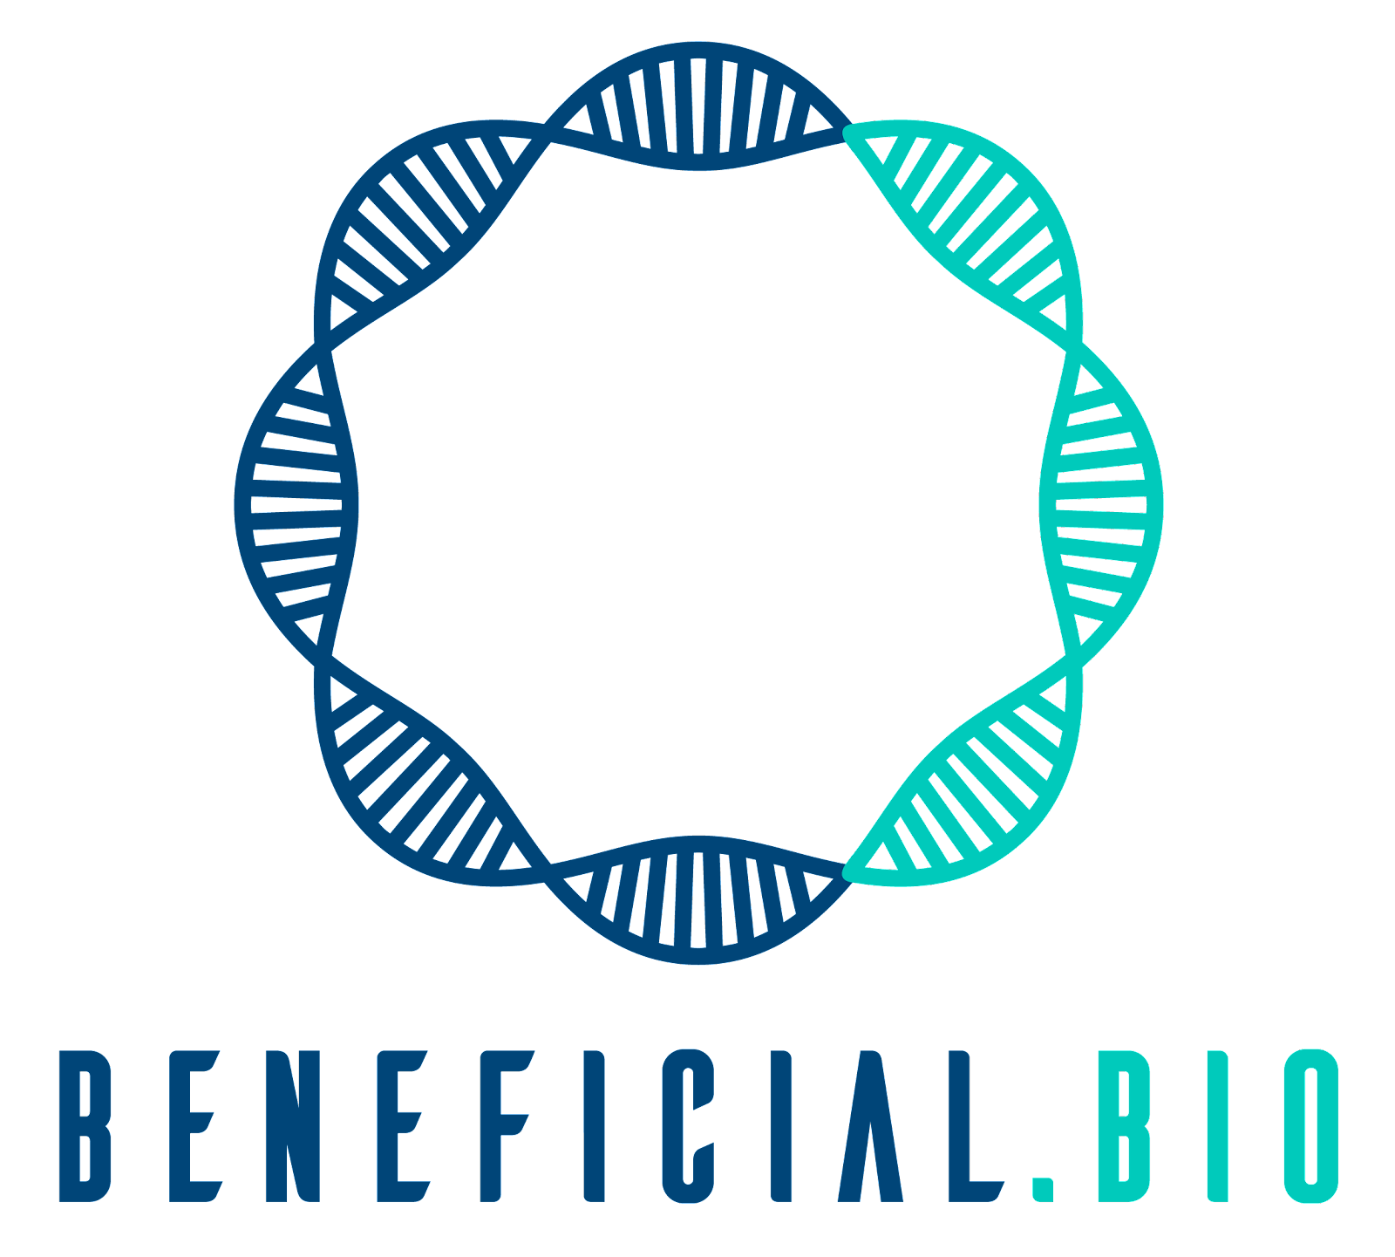
Biological Databases and Resources
WORKSHOP ON BIOINFORMATICS APPLICATIONS IN GENOMICS SURVEILLANCE OF BACTERIAL ANTIMICROBIAL RESISTANCE
22/02/2023
Stephane Fadanka, Diapa Nana Yanick
Mboalab Biotech | Beneficial Bio

Slide 2
Stephane Fadanka
Diapa Nana Yanick
Director, Special projects and Innovation
Ecosystem Mboalab Biotech,
- Sales Manager, Beneficial Bio Ltd
yanick@beneficial.bio
diapayanick2016@gmail.com
Executive Director, Mboalab Biotech
Managing Director (Cameroon), Beneficial Bio Ltd
SynBio Africa Emerging Leader,
OpenScience Ambassador (OLS-Cohort5),
Mentor (Outreachy, OLS).
Stephane@beneficial.bio
@StephaneFadanka
697465154 /679475748

Slide 3
Biological Databases and Resources
What is a database?
a database is defined as an organized collection of data or information that
is electronically stored and accessible from a computer system.
The organized nature of the database makes it easy to access, manage, periodically update, and rapidly search the required data/information from a suitable computer system.
Database or databank ?
From now on, the term « database » (db) is usually preferred

Slide 4
Biological Databases and Resources
A collection of...
structured
searchable (index) -> table of contents
updated periodically (release) -> new edition
cross-referenced (hyperlinks) -> links with other db
…data
Includes also associated tools (software) necessary for db access, db updating, db information insertion, db information deletion….
Data storage management: flat files, relational databases…

Slide 5
Biological Databases and Resources
Among various types of databases, the ones constituting the datasets relevant to biological sciences such as molecular biology and bioinformatics are called biological databases. In the current scenario.
Importance:
Rapidly advancing molecular biology, proteomics, and low-cost high-throughput genome sequencing technologies, huge amounts of biological information such as raw sequencing datasets, proteomes, etc. are being generated at a very rapid rate. Thus, the storage and handling of this staggering information are the major challenges of the current genomics era.
Biological databases enables the scientists to access and retrieve the biologically relevant data including the raw data, genome sequences, analyzed datasets, and annotations in easily manageable/organized formats.
Biological databases allow data indexing as well as help remove data redundancy. At present, biological databases have become the central component of bioinformatics. Through the various data mining tools, all biological information can be easily accessed; thus saving time, resources, and efforts.

Slide 6


Components of biological database
Similar to other databases, a biological database also has certain basic components:
Entity - An entity refers to the thing we want to store in a database. Eg. DNA sequences, Genes, Bibliographic references, etc.
Fields - The properties of an entity are called fields. Eg. Gene name, gene sequence,
Mutation (if any), etc.
Records - A record typically refers to a combination of all the fields for a given entity. For eg. Record for gene BRCA1 in GenBank
Identifier - The unique name which identifies a record.
In the case of a simple database, a single file contains multiple records. Among these
records, each one can have the same set of information (fields) along with a unique identifier.

Slide 7
Types of biological databases
Based on their content, the biological databases can be classified into the following types:
Primary databases
Primary databases, also known as the archival databases, basically contain experimentally
derived datasets such as nucleotide and protein sequences as well as the structural information of macromolecules. This basic information can be accompanied by functional annotation,
bibliographies, and links to other databases. The data to the primary database is directly submitted by researchers. Once submitted, the data is assigned an accession number, which is permanent and becomes a part of the scientific record.
The followings are examples of primary databases:
Primary nucleotide sequence databases - The European Nucleotide Archive (ENA), The National Center for Biotechnology Information GenBank (NCBI GenBank), and The DNA Data Bank of Japan (DDBJ), etc.
Microarray/Functional genomics databases - Gene Expression Omnibus (GEO) and Array Express Archives etc.
Protein sequences and structure databases - Swiss-Prot and Protein Information Resource (PIR) for protein sequences, Protein Databank (PDB) for protein structure.

Slide 8
Types of biological databases
Secondary databases
Secondary databases store the information derived from the analysis of primary datasets.
Secondary databases contain highly curated information derived from complex computational as
well as manual analysis of primary resources and scientific literature. These databases often store information about conserved domain structure/sequences, signal sequences, and active site residues.
Protein families, domains and structure databases - InterPro, PROSITE, SCOP, CATH and NCBI Conserved Domain Database (CDD)
Protein sequences and functional information databases - UniProt Knowledgebase (UniProtKB)
Nucleotide (Genes/Genomes) sequence and annotation databases - NCBI UniGene, The European Bioinformatics Institute (EBI) Genomes (EBI Genomes), and Ensembl, etc.
Specialized databases
These databases cater to the needs of specific research interests. Eg. Ribosomal Project
Database (RDP), HIV sequence database, The Saccharomyces Genome Database (SGD), Mouse
Genome Database (MGD), and Antibiotic Resistance Genes Database (ARDB), etc.

Slide 9
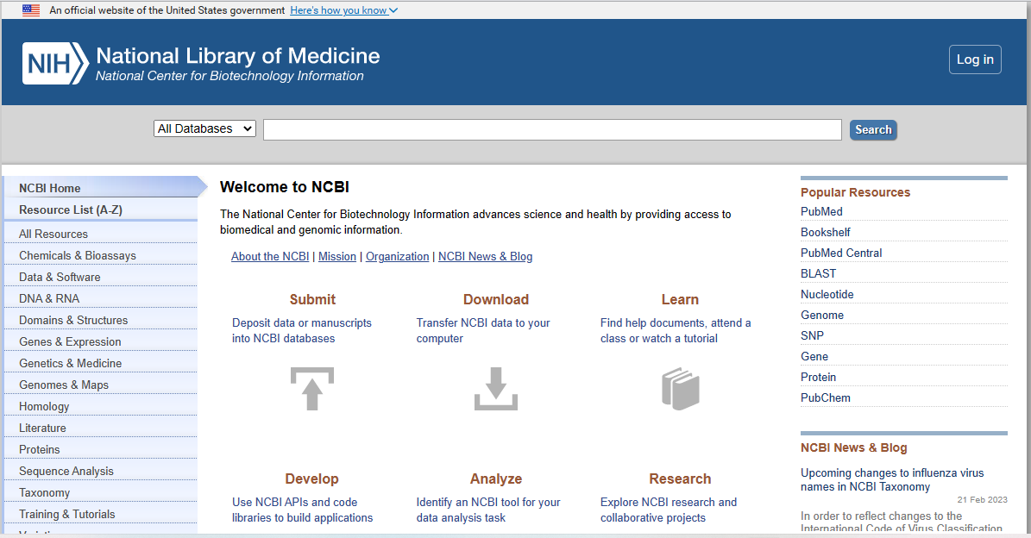
Important biological databases
Nucleotide sequence databases a. The National Center for Biotechnology Information GenBank
(NCBI GenBank) NCBI is a part of the National Library of Medicine (NLM) under the U.S. National Institute of Health (NIH).

Slide 10
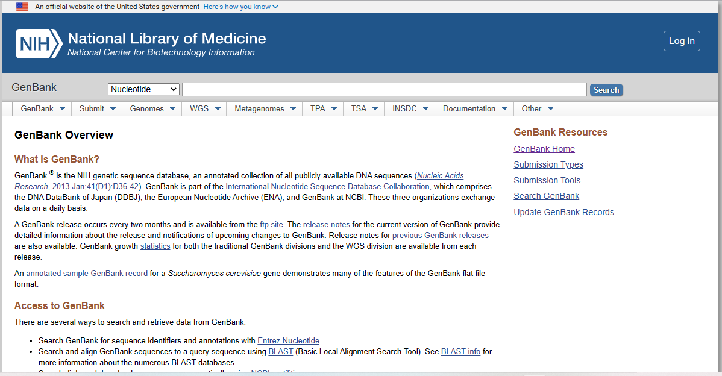
Important biological databases
GenBank is a publically available collection of nucleotide sequences, their protein sequences along with annotations

Slide 11
Important biological databases
GenBank is a publically available collection of nucleotide sequences, their protein sequences along with annotations
Some of the unique features of Genbank are:
Being a free public repository, any researcher can submit the sequences to GenBank without incurring any financial cost.
For the same gene or genome, multiple sequences of varying quality are available in GenBank. Essentially, anything submitted to GenBank is stored.
To represent the various modification done by the author, a sequence can have several versions.
Once a record is submitted to GenBank, it is assigned to a specific division based on the source taxonomy or sequencing strategy used to obtain the data. There are 12 taxonomic divisions and 8 functional divisions.
Each GenBank record containing a sequence is assigned a unique identifier called an accession number. The accession number is permanent, and it stays the same throughout the life of the record. Only changes may occur in the sequence version but not in the accession number. For eg. ACCESSION AF000001, VERSION AF000001.5

Slide 12
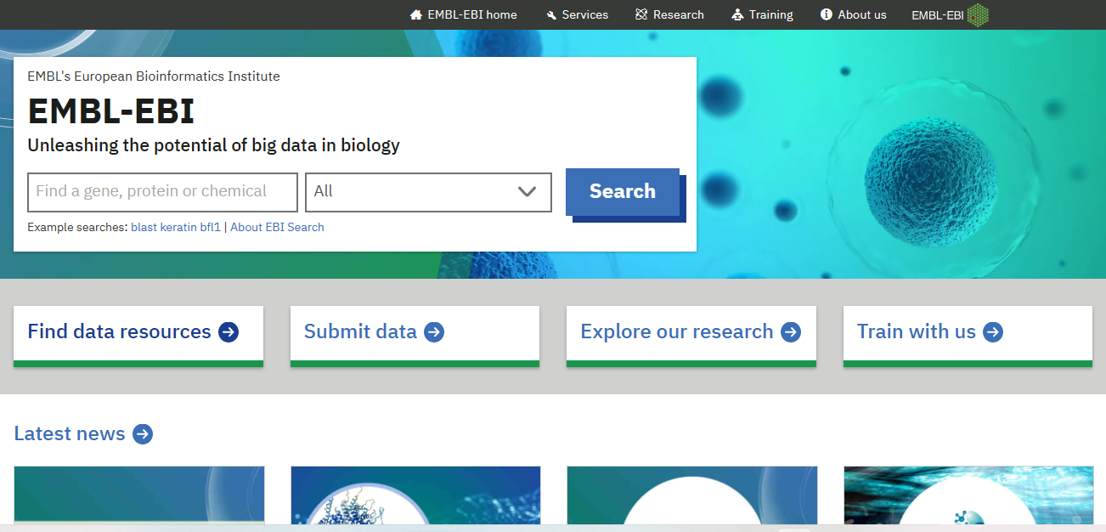
Important biological databases
B. EMBL: European Molecular Biology Laboratory: Similar to GenBank, the EMBL database (http://www.ebi.ac.uk/embl/index.html)
maintained at European Bioinformatics Institute (EBI) is part of the European Nucleotide Archive (ENA) aimed at constructing a
comprehensive catalog of the world's nucleotide sequencing information.

Slide 13
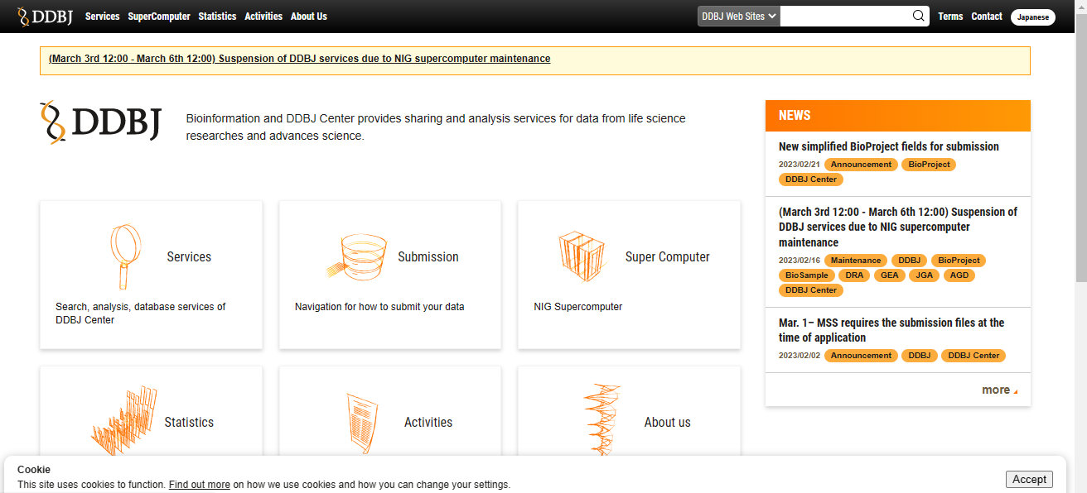
Important biological databases
C. DNA Data Bank of Japan (DDBJ) DDBJ (https://www.ddbj.nig.ac.jp/) is the only nucleotide sequence database located in
Asia. It was established in 1986 by the Center for Information Biology (CIB) under the National Institute of Genetics (NIG) of Japan
in collaboration with NCBI in the USA and EBI in Europe. A

Slide 14
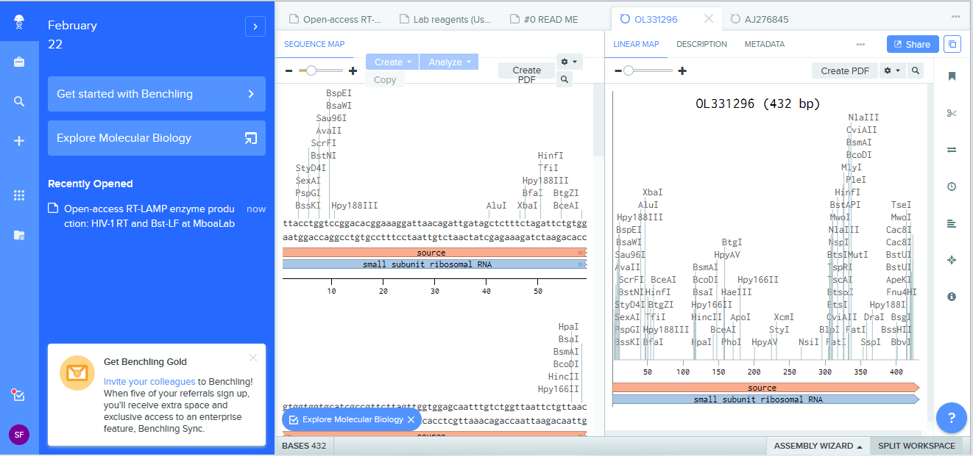
Bonus Ressource
Benchling
Benchling is a tool for virtually documenting your lab work. In addition to providing tools for writing and sharing protocols, it also has the functionalities for analyzing DNA and protein files, which is useful for in silico design of plasmids and oligos. Start by visiting Benchling and making a free account.

Slide 15
Thanks!
Stephane Fadanka
Stephanefadanka@gmail.com
https://github.com/Fadanka
@StephaneFadanka
Diapa Nana Yanick
yanick@beneficial.bio
diapayanick2016@gmail.com

